Slide 1

Module 2: Large-Scale Data Storage and Management

Slide 2
Agenda
Module 2: Large-Scale Data Storage and Management:
Hadoop Distributed File System (HDFS)
Apache Hadoop
Map Reduce Framework
Apache Spark
Scala
Spark SQL
PySpark
Examples

Slide 3
Introduction
What is Big Data?
Collection of large and complex data sets.
Difficult to process.
Challenges: capture, curation, storage, search, sharing, analysis, and visualization
Analysis of a single large set – useful to extract more info.
How?
find business trends
determine quality of research
prevent diseases
link legal citations
combat crime
determine real-time roadway traffic conditions

Slide 4
What is Big Data?
Volume: Large volumes clearly define Big Data. In some cases, the sheer size of the data makes it impossible to evaluate by more conventional means.
Variety: Data may come from a variety of sources and not necessarily be "related" to other data sources.
Velocity: The term velocity in this context refers to how fast the data can be generated and processed.
Variability: Data may be highly variable, incomplete, and inconsistent.
Complexity: Relationships between data sources may not be entirely clear and not amenable to traditional relational methods.

Slide 5

Hadoop
History:
Hadoop is an open-source software framework for storing and processing large datasets - gigabytes to petabytes.
Hadoop was developed at the Apache Software Foundation.
In 2008, Hadoop defeated the supercomputers and became the fastest system on the planet for sorting terabytes of data.
In November 2008, Google reported that its Mapreduce implementation sorted 1 terabyte in 68 seconds.
In April 2009, a team at Yahoo used Hadoop to sort 1 terabyte in 62 seconds, beaten Google MapReduce implementation.

Slide 6
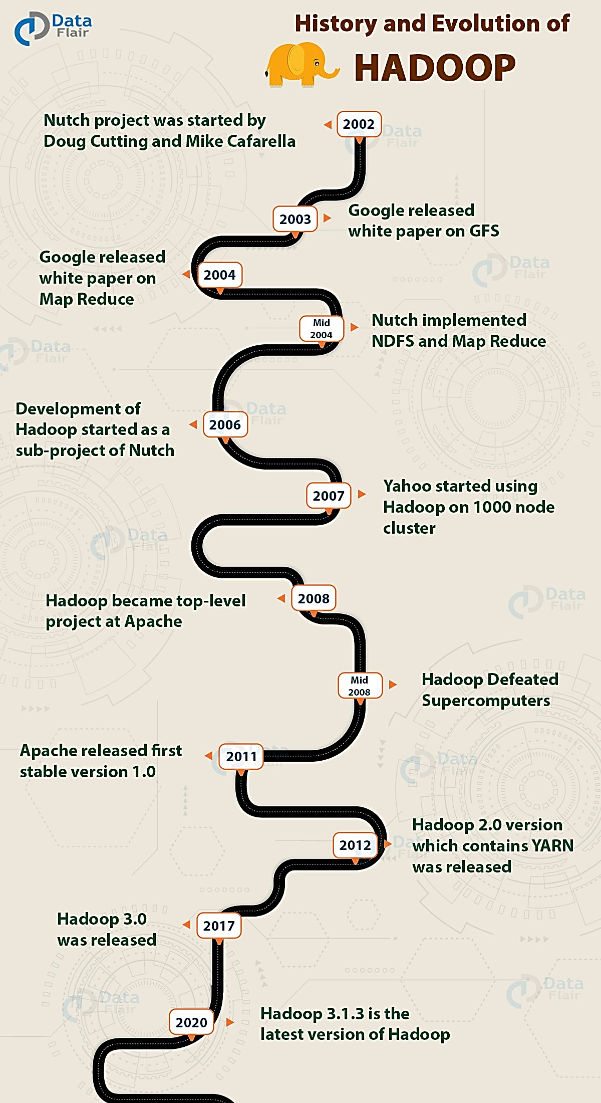
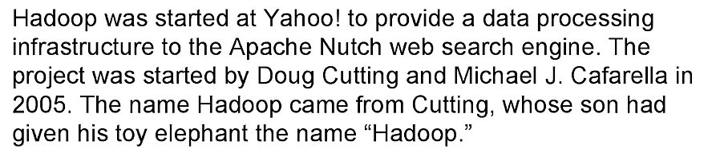
History of Hadoop

Slide 7
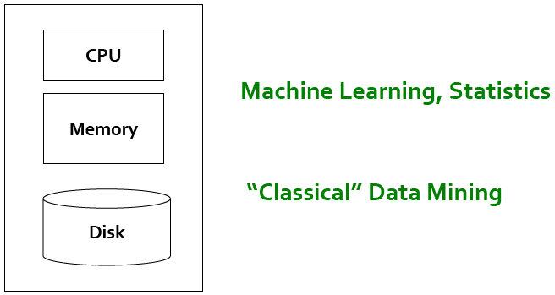
Single Node Architecture

Slide 8
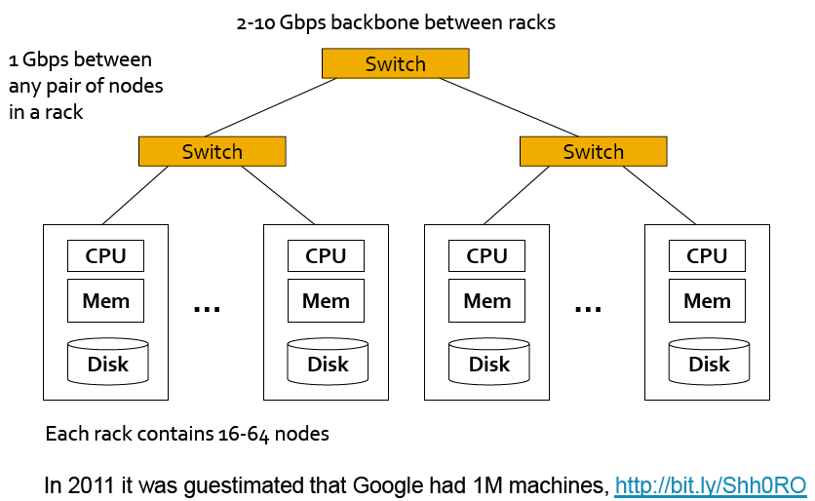
Cluster Architecture

Slide 9
Hadoop’s HDFS
The Hadoop Distributed File System (HDFS) was designed for Big Data processing.
HDFS is not designed as a true parallel file system.
Write-once/read-many model - enables other optimizations concurrency.
All additional writes are "append-only," no random writing to HDFS files.
Bytes are always appended to the end of a stream, and byte streams are guaranteed to be stored in the order written.
The design of HDFS is based on the design of the Google File System (GFS).
HDFS is designed for data streaming.
The HDFS block size is typically 64MB or 128MB.

Slide 10
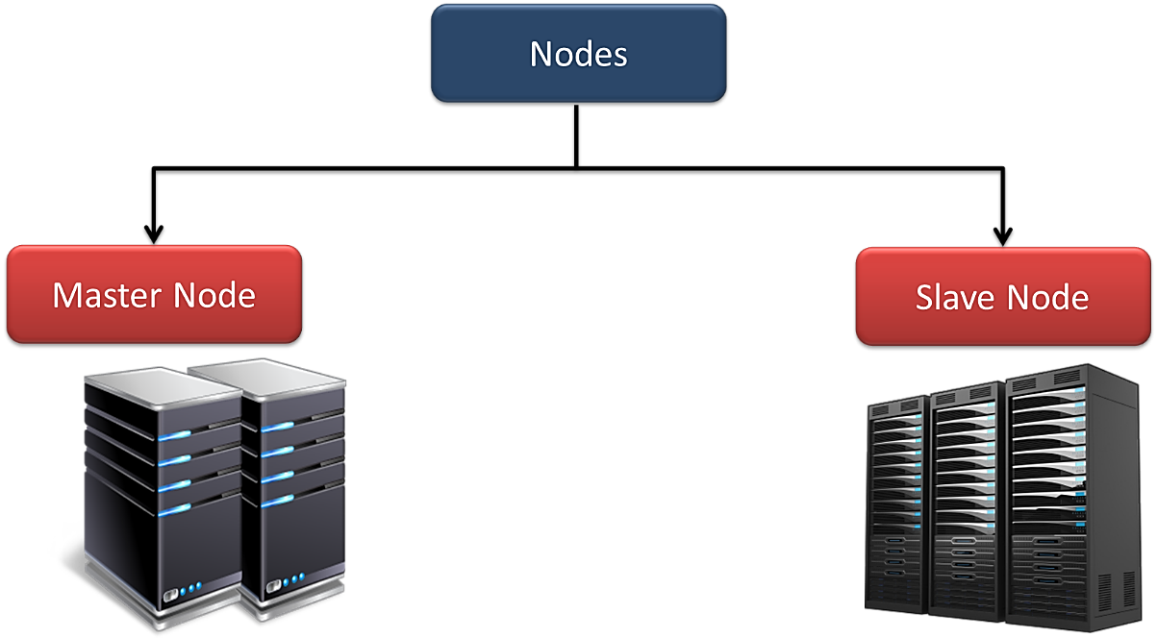
HDFS-Overview
Hadoop works in master-slave fashion, HDFS also has 2 types of nodes that work in the same manner.
namenode(s) and datanodes in the cluster.

Slide 11



How data is stored in HDFS
foo.txt: 3,9,6 bar.data: 2,4
block #9 of foo.txt?
3
9
Namenode
4
9
2
6
9
Read block 9
2
3
4
9
6
2
4
3
9
Client
Datanodes
Files are stored as sets of (large) blocks
Default block size: 64 MB (ext4 default is 4kB!)
Blocks are replicated for durability and availability
Namespace is managed by a single name node
Actual data transfer is directly between client & data node

Slide 12
NameNode
Namenode regulates file access to the clients.
It maintains and manages the slave nodes and assign tasks to them.
Namenode executes file system namespace operations like opening, closing, and renaming files and directories.
Name node stores metadata like filename, the number of blocks, number of replicas, a location of blocks, block IDs etc.
This metadata is available in memory in the master for faster retrieval of data.
It should be deployed on reliable hardware.

Slide 13
DataNodes
There are n number of slaves (where n can be upto 1000) or datanodes in HDFS which manage storage of data.
Slave nodes are the actual worker nodes which do the tasks and serve read and write requests from the file system’s clients.
Perform block creation, deletion, and replication upon instruction from the NameNode.
Once a block is written on a datanode, it replicates it to other datanodes.
Datanodes can be deployed on commodity Hardware and we need not deploy them on very reliable hardware.

Slide 14
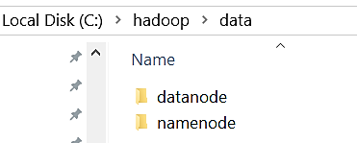
Hadoop Setup on Windows 10
We need Java JDK8 & Hadoop 3.1.4
Create a folder 'data' in Hadoop home C:\hadoop\data and 'namenode' and 'datanode' folders under data.
Edit hdfs-site.xml
<configuration>
<property>
<name> dfs.replication</name>
<value>1</value>
</property>
<property>
<name>dfs.namenode.name.dir</name>
<value>C:\hadoop\data\namenode</value>
</property>
<property>
<name>dfs.datanode.data.dir</name>
<value>C:\hadoop\data\datanode</value>
</property>
</configuration>

Slide 15
HDFS Commands – Starting HDFS & YARN
1. Starting Hadoop HDFS:
c:\hadoop\sbin>start-dfs
2. Starting YARN:
c:\hadoop\sbin>start-yarn
3. Check the status:
c:\hadoop\sbin>jps /* Java Virtual Machine Process Status */
13712 ResourceManager
12452 NodeManager
15316 Jps
868 NameNode
13560 DataNode

Slide 16
HDFS Commands
1. Create a directory called user:
c:\hadoop\sbin>hdfs dfs -mkdir /user
2. Copy the file Hello.java from local drive to /user and display the file:
c:\hadoop\sbin>hdfs dfs -copyFromLocal D:\Hello.java /user
c:\hadoop\sbin>hdfs dfs -cat /user/Hello.java
/* First Java program to say Hello */
public class Hello { // Save as "Hello.java" under "d:\myProject"
public static void main(String[] args) {
System.out.println("Hello, world!");
}
}
3. List Files in /user directory
c:\hadoop\sbin>hdfs dfs -ls /user
Found 1 items
-rw-r--r-- 1 Admin supergroup 210 2024-08-10 10:47 /user/Hello.java

Slide 17
Hadoop MapReduce Framework
Software framework- multi-terabyte data-sets of data in-parallel on large clusters.
A MapReduce job usually splits the input data-set into independent chunks which are processed by the map tasks in a completely parallel manner.
The framework sorts the outputs of the maps, which are then input to the reduce tasks.
Simple Example:
Assume that you want to count the frequency of occurrence of the word “data” in the book “Big Data Analytics”.
Call 20 friends and give each chapter in the book to search- “MAP” task.
After all 20 completed counting, simply sum it - “Reduce” task.

Slide 18
Wordcount Problem
MapReduce is a programming model for performing parallel processing on large data sets.
Mapreduce Algorithm:
Step 1: Use a mapper function to turn each item into zero or more key-value pairs.
Step-2: Collect together all the pairs with identical keys.
Step 3: Use a reducer function on each collection of grouped values to produce output values for the corresponding key.

Slide 19


A realworld Scenario
Mapreduce

Slide 20
Example-1: Word count
Key range the node is responsible for
(apple, 3)
(apple, 1)
(apple, 1)
(apple, 1)
Mapper (1-2)
(apple, {1, 1, 1})
Reducer (A-G)
(an, 2)
(an, {1, 1})
(an, 1)
(an, 1)
(because, 1)
(1, the apple)
(because, {1})
(because, 1)
(green, 1)
(green, {1})
(2, is an apple)
(green, 1)
Mapper (3-4)
(is, 1)
(is, 1)
Reducer (H-N)
(is, 2)
(3, not an orange)
(is, {1, 1})
(not, 1)
(not, 1)
(not, 2)
(not, {1, 1})
(4, because the)
(5, orange)
(orange, 1)
(orange, 1)
(orange, 1)
Mapper (5-6)
(orange, {1, 1, 1})
Reducer (O-U)
(orange, 3)
(the, 1)
(the, {1, 1, 1})
(6, unlike the apple)
(the, 1)
(the, 1)
(the, 3)
(unlike, {1})
(unlike, 1)
(7, is orange)
(unlike, 1)
(8, not green)
Mapper (7-8)
Reducer (V-Z)
2
The reducers process their input one group at a time
1
The mappers process the KV-pairs one by one
Each KV-pair output by the mapper is sent to the reducer that is responsible for it
5
Each mapper receives some of the KV-pairs as input
3
4
The reducers sort their input by key and group it

Slide 21
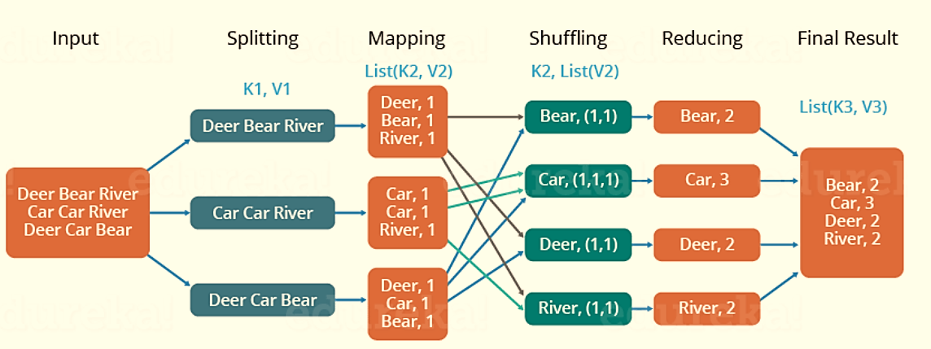
Example 2
3 documents, the key is the word and the value is the number of times that the word appears in the document:

Slide 22
Wordcount in Hadoop
7. Wordcount Program Demo
(a) Create a directory /input
c:\hadoop\sbin>hdfs dfs -mkdir /input
Create data.txt
Hello
California
Scott
Hello
Iceland
Nandagopalan
California
Scott
India
America
(b) Copy the input data.txt file to /input folder
c:\hadoop\sbin>hdfs dfs -copyFromLocal D:\WordCountTutorial\InputData\data.txt /input
(c) Create a directory /out
c:\hadoop\sbin>hdfs dfs -mkdir /out

Slide 23
Wordcount in Hadoop…
(d) Execute the mapreduce jar file located in the Hadoop/share folder and store the result in /out folder
c:\hadoop\sbin>hadoop jar C:/hadoop/share/hadoop/mapreduce/hadoop-mapreduce-examples-3.1.4.jar wordcount /input /out
(e) Output files in /out folder:
c:\hadoop\sbin>hdfs dfs -ls /out
Found 2 items
-rw-r--r-- 1 Admin supergroup 0 2024-08-10 14:44 /out/_SUCCESS
-rw-r--r-- 1 Admin supergroup 72 2024-08-10 14:44 /out/part-r-00000
(f) Display the Result
c:\hadoop\sbin>hdfs dfs -cat /out/*
America 1
California 2
Hello 2
Iceland 1
India 1
Nandagopalan 1
Scott 2
For more details on creating and executing mapreduce java programs, click:
https://medium.com/@tirthshah100/word-count-in-apache-hadoop-mapreduce-c6ee8e737fb9

Slide 24
Apache Spark
Spark is an in-memory cluster computing framework for processing and analyzing large amounts of data.
Spark is faster than Hadoop MapReduce.
Spark provides a unified integrated platform for different types of data processing jobs.
Spark is scalable.
Spark is fault tolerant.
Expressive program model implements a number of mathematical and logic operations with smaller and easier written codes.

Slide 25
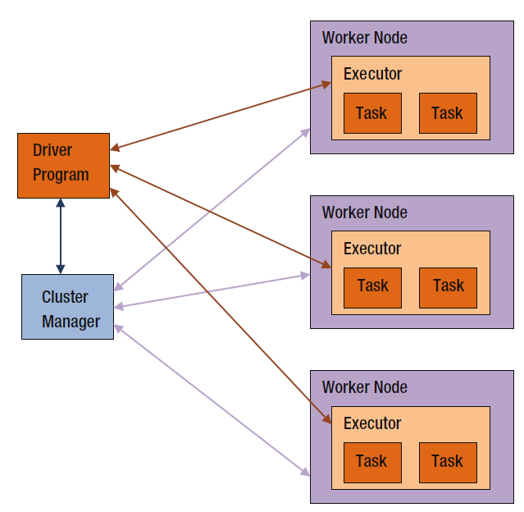
Spark Architecture
A worker provides CPU, memory, and storage resources to a Spark application.
A cluster manager to acquire cluster resources for executing a job.

Slide 26
Workers
A worker provides CPU, memory, and storage resources to a Spark application.
The workers run a Spark application as distributed processes on a cluster of nodes.

Slide 27
Driver
The driver is the master node that controls the execution of parallel operations on the cluster. It is responsible for:
Converting user programs into tasks.
Scheduling tasks on executors.
Coordinating between executors.
Tracking the progress of tasks and handling failures.

Slide 28
Cluster Manager
The cluster manager allocates resources across the cluster.
Standalone Cluster Manager: A simple cluster manager is included with Spark that makes it easy to set up a cluster.
Apache Mesos: A general cluster manager that can run Hadoop MapReduce and other applications.
Hadoop YARN: The resource manager in Hadoop 2.0 that manages the resources of a Hadoop cluster.

Slide 29
Executors
Executors are worker nodes in the cluster that run individual tasks. Each application has its own executors that:
Execute code assigned to them by the driver.
Report the status of computation and storage to the driver.

Slide 30
Tasks
Tasks are the smallest unit of work in Spark.
They are a part of a job, which is divided into stages.
Each stage is further divided into tasks that run on individual executors.
Tasks are assigned to executors based on data locality and resource availability.

Slide 31
How code is executed on a Spark cluster?
Shuffle. A shuffle redistributes data among a cluster of nodes.
Job. A job is a set of computations that Spark performs to return results to a driver program.
Stage. A stage is a collection of tasks. Spark splits a job into a DAG of stages.
When a Spark application is run, Spark connects to a cluster manager and acquires executors on the worker nodes.
The executors run the tasks submitted by Spark in parallel.

Slide 32
SparkContext
SparkContext is a class defined in the Spark library. It is the main entry point into the Spark library.
It represents a connection to a Spark cluster.
val sc = new SparkContext()

Slide 33

Scala

Slide 34
Scala
Functional Programming
Functional programming is a programming style that uses functions as a building block and avoids mutable variables, loops, and other imperative control structures.
It treats computation as an evaluation of mathematical functions, where the output of a function depends only on the arguments to the function.
It makes it easier to write concurrent or multithreaded applications.
A function is a block of executable code.
E.g. Consider f(x) = x*2 and g(x) = x+2
h(x) = f(g(x)) = f(x+2) = (x+2)*2

Slide 35
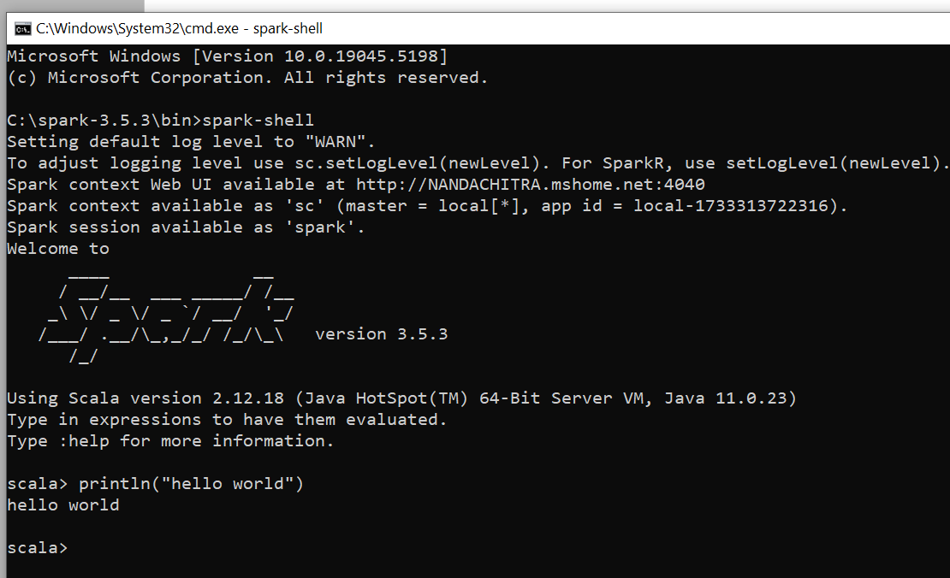
Scala - Basics
Scala is a hybrid programming language that supports both object-oriented and functional programming.
Scala Interpreter – Shell prompt
Resilient Distributed Datasets (RDDs) are the primary data structure.
Used to store and process large amounts of data.

Slide 36
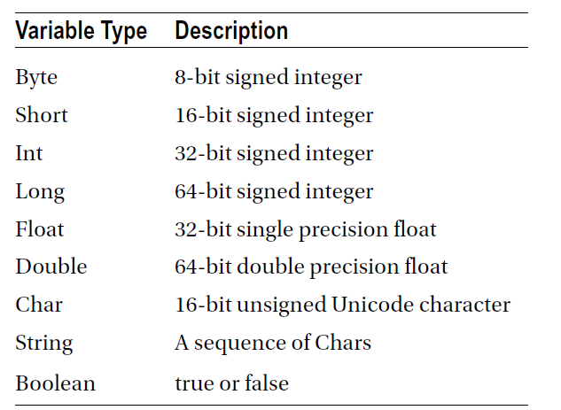
Scala Data Types
A mutable variable is declared using the keyword var; whereas an immutable variable is declared using the keyword val.

Slide 37
Functions
A function can be used like a variable.
def add(firstInput: Int, secondInput: Int): Int = {
val sum = firstInput + secondInput
return sum
}
scala> val x = add(3,4)
x: Int = 7
scala> x
res2: Int = 7

Slide 38
Classes
class Car(mk: String, ml: String, cr: String) {
val make = mk
val model = ml
var color = cr
def repaint(newColor: String) = {
color = newColor
}
}
Instance:
val Fordcar= new Car("Ford", "Mustang", "Red")
val Hondacar = new Car("Honda", "City", "Black")

Slide 39
A Standalone Scala Application
object HelloWorld {
def main(args: Array[String]): Unit = {
println("Hello World!")
}
}

Slide 40
Spark SQL
Spark SQL is a Spark library that runs on top of Spark.
Data Processing: data stored in a database, NoSQL data store, Parquet, ORC, Avro, JSON, CSV, or any other structured format.
Spark SQL seamlessly integrates with other Spark libraries such as Spark Streaming, MLib, Spark ML, and GraphX.
Data sources: file, a NoSQL datastore, or a database.
Spark SQL can be used as a data virtualization system for integrating heterogeneous data sources.
Spark SQL can be used as a distributed SQL query engine and also provides JDBC/ODBC connectivity.

Slide 41
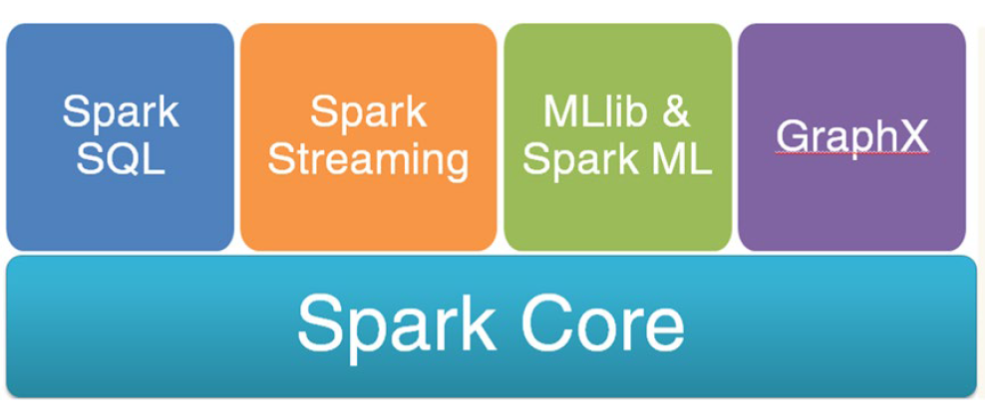
Spark Libraries

Slide 42
SQLContext
SQLContext is the main entry point into the Spark SQL library.
It is a class defined in the Spark SQL library.
A Spark SQL application must create an instance of the SQLContext or HiveContext class.
SQLContext: Designed to work with structured data and provides SQL capabilities.
SparkContext: The core Spark context for managing the cluster and basic RDD operations.

Slide 43
Creating SQL instance
import org.apache.spark.SparkConf
import org.apache.spark._
import org.apache.spark.sql._
val config = new SparkConf().setAppName("My Spark SQL app")
val sqlContext = new SQLContext(sc)
import java.sql.DriverManager
// Assuming you have a Spark session named "spark"
val jdbcDF = spark.read
.format("jdbc")
.options(Map(
"url" -> "jdbc:mysql://localhost:3306/studentdatabase",
"user" -> "root",
"password" -> "admin",
"dbtable" -> "student"
))
.load()
// Execute a query on the loaded data
val results = jdbcDF.sql("SELECT * FROM student;")
results.show()

Slide 44
Creating a DF from CSV file
Create a employee.csv file: Name, Age, Gender
scala> val linesRDD = sc.textFile("E:/PySparkProjects/data/employee.csv")
scala> val rowsRDD = linesRDD.map{row => row.split(",")}
scala> import org.apache.spark.sql.types.{StructType, StructField, StringType, IntegerType};
Scala>val schema = StructType(List(
StructField("name", StringType, false),
StructField("age", IntegerType, false),
StructField("gender", StringType, false)
) )
val employeeDF = sqlContext.createDataFrame(rowsRDD,schema)

Slide 45
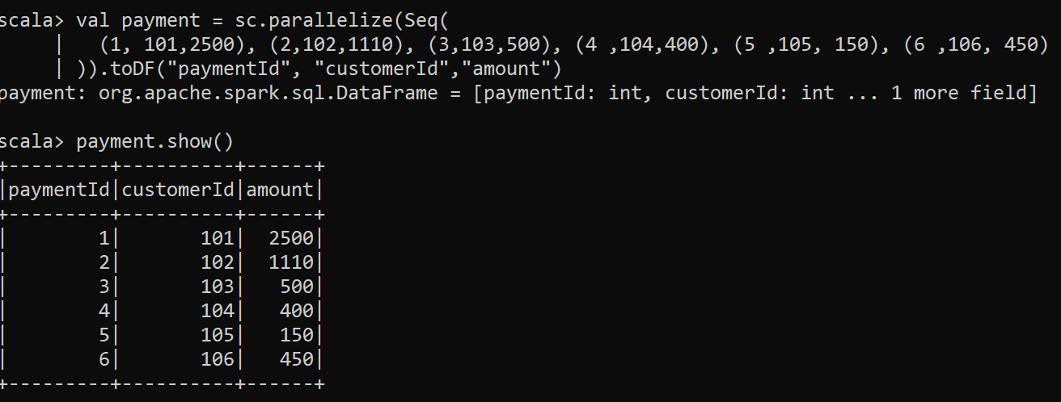
Joins in Spark SQL
val payment = sc.parallelize(Seq( (1, 101,2500), (2,102,1110), (3,103,500), (4 ,104,400), (5 ,105, 150), (6 ,106, 450) )).toDF("paymentId", "customerId","amount")

Slide 46
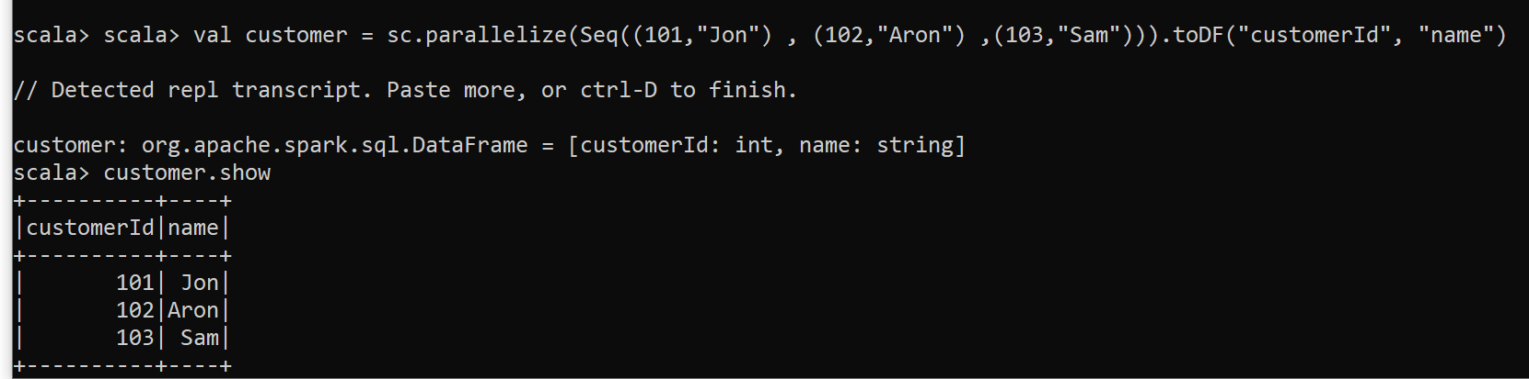
Contd…
val customer = sc.parallelize(Seq((101,"Jon") , (102,"Aron") ,(103,"Sam"))).toDF("customerId", "name")

Slide 47
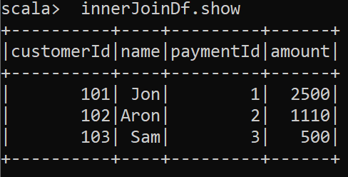
Inner Join
val innerJoinDf = customer.join(payment,"customerId")
More details: https://medium.com/@achilleus/https-medium-com-joins-in-apache-spark-part-1-ce289bfc84c9

Slide 48

PySpark
PySpark is a powerful open-source framework built on Apache Spark.
Designed to simplify and accelerate large-scale data processing and analytics tasks.
Offers a high-level API for Python programming language, enabling seamless integration with existing Python ecosystems.
PySpark is very well used in the Data Science and Machine Learning community.

Slide 49
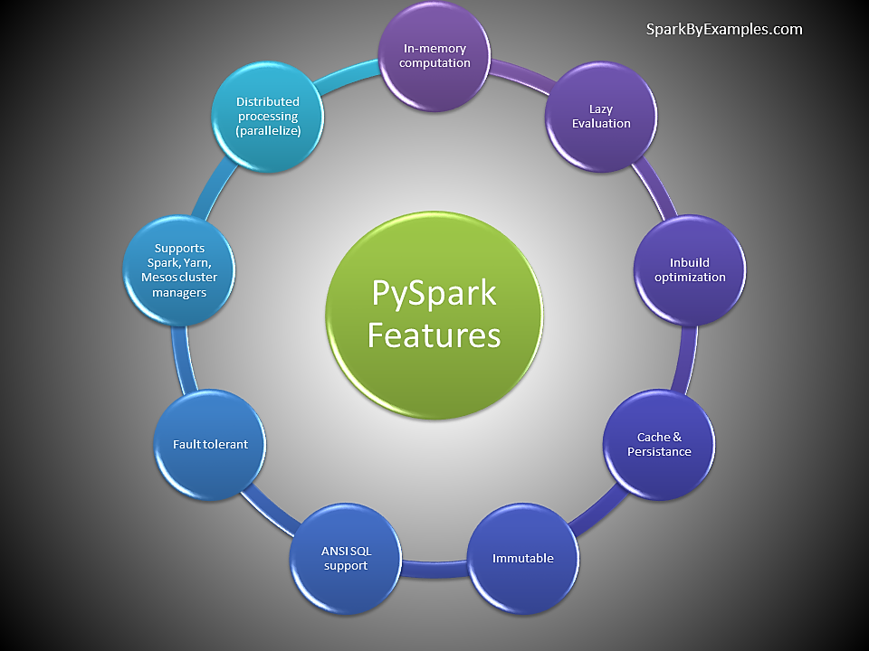
Features of PySpark

Slide 50
Example
# Basic PySpark Example - Extract from .csv and transform
from pyspark.sql import SparkSession
# Create a SparkSession
spark = SparkSession.builder.appName("BasicPySparkExample").getOrCreate()
# Read data from a CSV file
df = spark.read.csv("E:/PySparkProjects/data/input.csv", header=True, inferSchema=True)
# Select specific columns
filtered_df = df.select("Surname", "Email")
# Show the results
filtered_df.show()
# Stop the SparkSession
spark.stop()

Slide 51
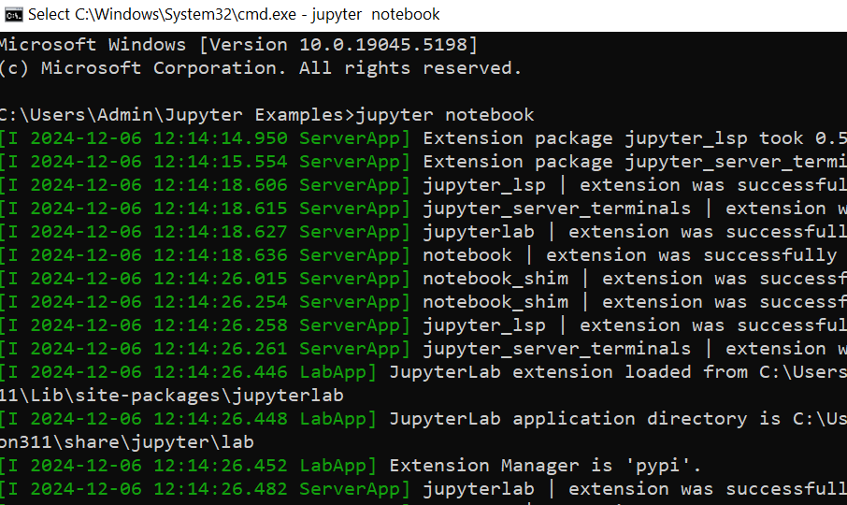
PySpark, Jupyter & SQL
Go to the desired folder & type Jupyter notebook:

Slide 52
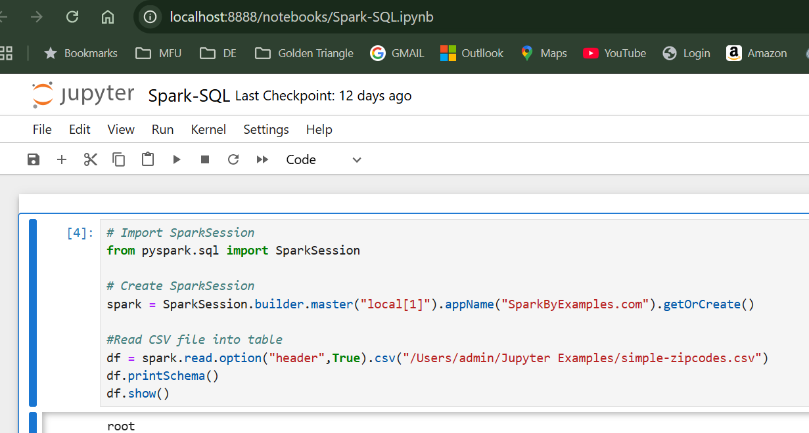
Web UI
Your Brower looks like this:

Slide 53
Example
# Import SparkSessionfrom pyspark.sql import SparkSession# Create SparkSession spark =
SparkSession.builder.master("local[1]").appName("SparkByExamples.com").getOrCreate()
#Read CSV file into tabledf = spark.read.option("header",True).csv("/Users/admin/Jupyter
Examples/simple-zipcodes.csv")df.printSchema()df.show()
# Create temporary table
spark.read.option("header",True).csv("/Users/admin/Jupyter Examples/simple-
zipcodes.csv").createOrReplaceTempView("Zipcodes")
# DataFrame API Select query
df.select("country","city","zipcode","state").show(5)
# DataFrame API where()
df.select("country","city","zipcode","state").where("state == 'TX'").show()
result = spark.sql(""" SELECT country, city, zipcode, state FROM ZIPCODES WHERE state = 'AZ' """)

Slide 54
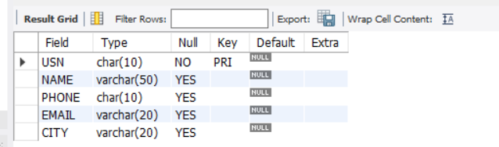
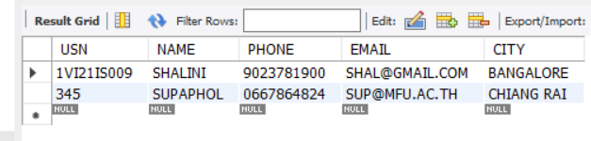
PySpark & MySQL
Create a table “student” in MySQL workbench.
Populate the table with sample data.

Slide 55
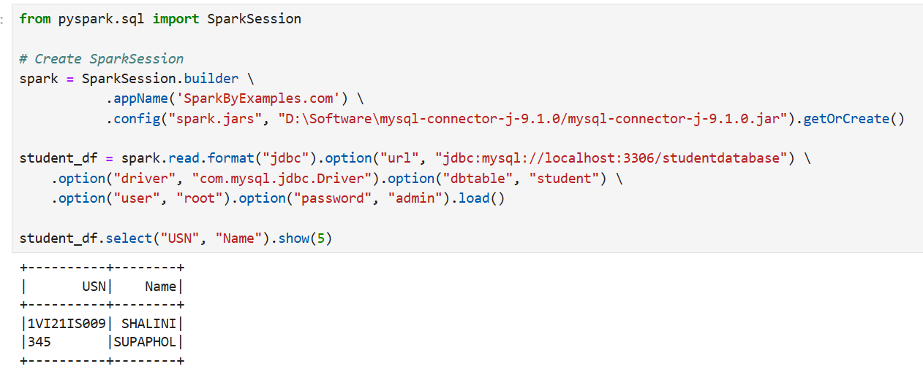
PySpark & MySQL on Jupyter
Download the jar file from the mysql website.
Select platform independent jar option to download (ZIP file).
In our case: D:\Software\mysql-connector-j-9.1.0
Type the below code in Jupyter:

Slide 56
PySpark & MySQL on VS Code
Download the jar file from the mysql website.
Select platform independent jar option to download (ZIP file).
In our case: D:\Software\mysql-connector-j-9.1.0
Type the below code in VS Code:
from pyspark.sql import SparkSession
# Create SparkSession
spark = SparkSession.builder.appName('SparkByExamples.com') \
.config("spark.jars", "D:\Software\mysql-connector-j-
9.1.0/mysql-connector-j-9.1.0.jar").getOrCreate()
student_df = spark.read.format("jdbc").option("url",
"jdbc:mysql://localhost:3306/studentdatabase") \
.option("driver", "com.mysql.jdbc.Driver").option("dbtable", "student")\
.option("user", "root").option("password", "admin").load()
student_df.select("USN", "Name").show(5)

Slide 57
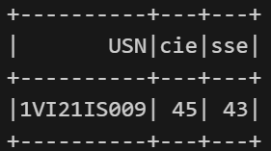
Extracting Data from specific query
query_df = spark.read.format("jdbc") \
.option("url", "jdbc:mysql://localhost:3306/studentdatabase") \
.option("driver", "com.mysql.jdbc.Driver") \
.option("query", "SELECT * FROM marks") \
.option("user", "root").option("password", "admin").load()
query_df.select("USN","cie","sse").show()

Slide 58
Thank You

